Slide 1

Practical 4
Implementation of Circular Queue

Slide 2

Lesson Plan
Subject/Course | Competitive Coding
Lesson Title | Implementation of Circular Queue
Lesson Objectives
To explain the concept and purpose of a circular queue and how it differs from a linear queue.
To implement circular queue operations (enqueue, dequeue, front, rear, isFull, isEmpty) using an array-based approach in code.
Evaluate the time and space complexity of common circular queue operations.
To identify suitable scenarios in computer science or real-life where Circualr Queue is applicable and efficient.

Slide 3
Problem Statement:
Write a program to design a circular queue(k) which Should implement the below functions
a. Enqueue
b. Dequeue
c. Front
d. Rear

Slide 4
Introduction to the Problem
A Circular Queue is a linear data structure that follows the FIFO (First In First Out) principle.
Unlike a normal queue, the last position is connected back to the first position to make a circle.
This structure efficiently utilizes memory by reusing empty spaces created by dequeued elements.

Slide 5
Concept and Background
Circular Queue connects the end of the queue back to the front.
It prevents wastage of space in a linear queue when elements are dequeued.
It can be implemented using Arrays, Linked List etc.
Two pointers are maintained:
front → points to the first element.
rear → points to the last element.
The queue is full when (rear + 1) % size == front.
The queue is empty when front == -1.

Slide 6
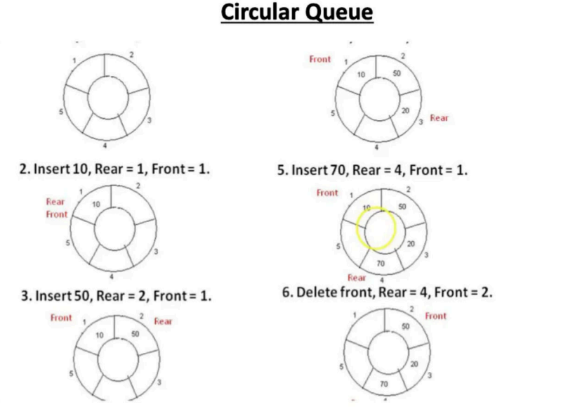
Visualization
1.
4.Insert 20,Rear=3, Front =1

Slide 7
Queue Operations
1. Enqueue (Insert): Add an element at the rear.
- Check if the queue is full.
- Update rear = (rear + 1) % size.
- Insert element at rear.
2. Dequeue (Delete):Remove an element from the front.
- Check if the queue is empty.
- Update front = (front + 1) % size.
3. Peek: Retrieve the front element without removing it.
4. Display: Print elements from front to rear circularly.

Slide 8
Conditions for Queue State
• Queue Full Condition:
(rear + 1) % size == front
• Queue Empty Condition:
front == -1
• Reset Condition after last Dequeue:
If front == rear, then set front = rear = -1

Slide 9
Algorithm/Logic
ENQUEUE(x):
1. If (rear + 1) % size == front → Overflow
2. Else if front == -1 → front = rear = 0
3. Else → rear = (rear + 1) % size
4. queue[rear] = x
DEQUEUE():
1. If front == -1 → Underflow
2. x = queue[front]
3. If front == rear → front = rear = -1
4. Else → front = (front + 1) % size

Slide 10
Algorithm/Logic
Front(x):
1. If front != -1, then queue[front] is the front item.
Rear():
1. If rear != -1, then queue[rear] is the rear item.

Slide 11
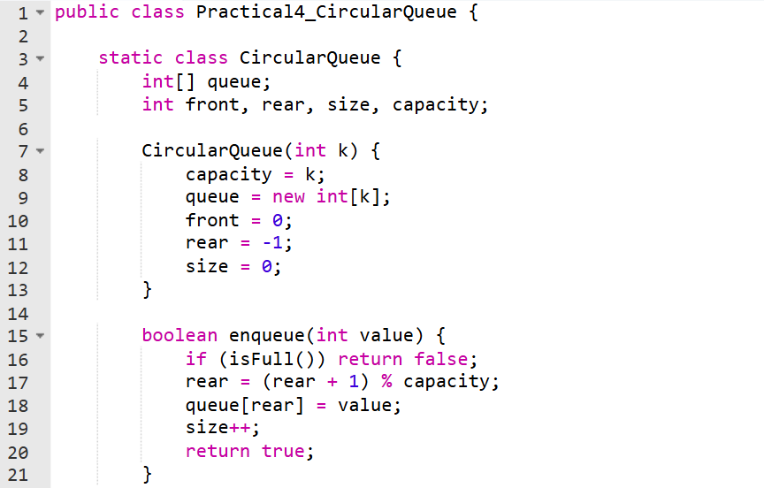
Code Implementation

Slide 12
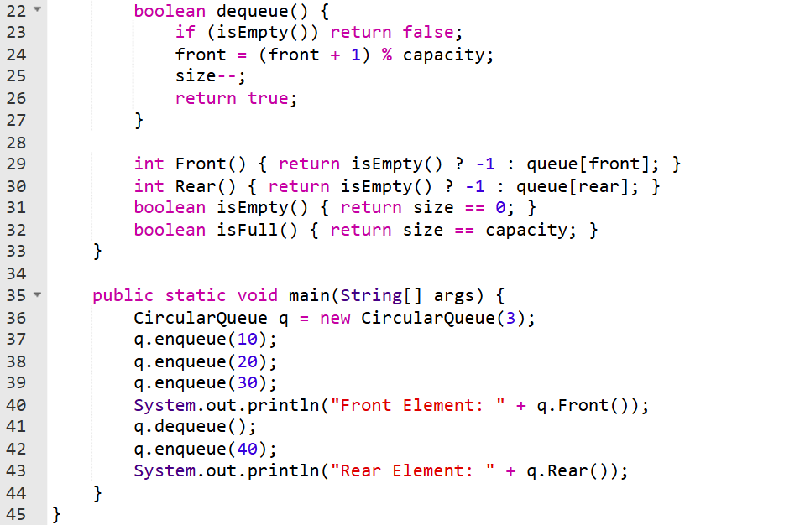

Slide 13
Output :
Front Element: 10
Rear Element: 40

Slide 14
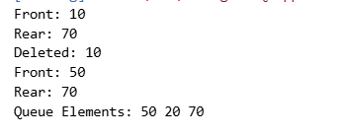
Output

Slide 15
Time & Space Complexity
• Enqueue Operation: O(1)
• Dequeue Operation: O(1)
• Peek Operation: O(1)
• Display Operation: O(n)
• Space Complexity: O(n)
Circular Queue provides efficient memory use and constant-time operations.

Slide 16
Summary
Implemented a Circular Queue of capacity k supporting operations: enqueue, dequeue, front, and rear.
Used modular arithmetic to connect the last index back to the first, avoiding wasted space.
Handled overflow (queue full) and underflow (queue empty) conditions effectively.
Demonstrated the difference between linear queue and circular queue, emphasizing better memory utilization.
Strengthened understanding of queue data structure, front/rear pointers, and FIFO principle in data handling.

Slide 17
Practice Questions:
Design Circular Queue (Problem 622)
🔗 https://leetcode.com/problems/design-circular-queue/
Concept: Implement a basic circular queue using fixed-size array storage. Handle front/rear pointer rotation, full/empty conditions, and efficient enqueue/dequeue in O(1).
Why Practice: This is the closest LeetCode match to your question — builds mastery in implementing circular buffer and understanding wrap-around behavior.

Slide 18
Practice Questions:
2. Design Circular Deque (Problem 641)
🔗 https://leetcode.com/problems/design-circular-deque/
Concept: Implement a circular deque using an array with front and rear pointers. Operations include insert/delete at both ends, checking full/empty, and maintaining circular movement with modulo arithmetic.
Why Practice: Directly strengthens understanding of circular array logic, pointer movement, capacity checks, and how queues can be extended to double-ended operations.

Slide 19
Practice Questions:
3. Find the Winner of the Circular Game (Problem 1823)
🔗 https://leetcode.com/problems/find-the-winner-of-the-circular-game/
Concept: Simulates players standing in a circle and eliminating every k-th person until one remains. Uses circular indexing or Josephus problem logic to determine the final winner.
Why Practice: Strengthens understanding of circular movement, modular indexing, and how elements are removed in a loop — closely related to circular queue behavior.

Slide 20
Thanks

